Slide 1
Year 1 and 2 Parent Workshop
Year 1:
Mrs Baskerville = s.baskerville@chalkridgepri.hants.sch.uk
Mrs Keat = n.keat@chalkridgepri.hants.sch
Year 2:
Miss Hare = k.hare@chalkridgepri.hants.sch.uk
Miss O’Brien = s.o’brien@chalkridgepri.hants.sch.uk

Slide 2
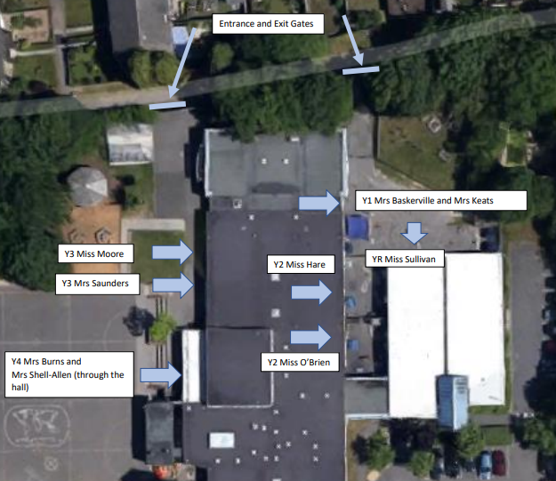
Drop off and Pick up
The gates are opened at 8:30am.
Classroom doors are opened at 8:40am. Children should arrive between 8:40am-8:50am.
If children arrive after 8:50am they need to go through the office and will be marked as late.
Children to be picked up at 3:10pm at the same place as they were dropped off.
Notes:
RSA

Slide 3
School Uniform
Navy-blue jumper/sweatshirt or cardigan (no hooded tops);
Light blue polo shirt, shirt or blouse;
Grey trousers, skirt or pinafore dress (summer cotton dress in blue and white);
White, navy-blue or grey socks/tights;
Conventional outdoor shoes in dark colours (conventional sandals may be worn in the summer);
Hair longer than shoulder length tied up in plain coloured hairbands.

Slide 4
PE School Uniform
Light blue t-shirt;
Navy blue PE briefs, shorts, jogging bottoms or wrap over games skirt;
Light blue fleece or sweatshirt (no hooded tops);
Trainers or plimsolls for outdoor PE.
Safety Notes
Earrings should be removed during all PE activities (taped if newly pierced).
All indoor PE in bare feet.
Hair longer than shoulder length tied up in plain coloured band.
No hooded tops allowed.

Slide 5
Equipment Needed
Your children will not be required to bring their own pencil
cases or equipment as this will be provided for them.
PE kit will be need to be worn into school on days where PE is taught.
Year 1 – Tuesday and Friday
Year 2H – Tuesday and Wednesday
Year 20 – Tuesday and Friday
Please note, children are not allowed to bring toys or fiddle toys from home. Fiddle toys will be provided where needed.

Slide 6
Reading
Regularly listening to your child read and reading to your child will
benefit them.
Through reading, children can:
Develop their sense of self
Improve emotional literacy
Develop empathy
“A love of reading is the biggest indicator of future academic success.”
OECD (The Organisation for Economic Co-operation and Development)

Slide 7
Reading at home
Reading Records
Every time you read with your child at home, please record in their reading record.
Reading Raffle
Read at home with your child as often as possible, or at least 5 x a week.
5 x a week = entered into reading raffle at the end of every month.
25 reads
Every 25 reads that are recorded in your child’s reading record, they will receive a certificate.
Aim for 200 or more!

Slide 8
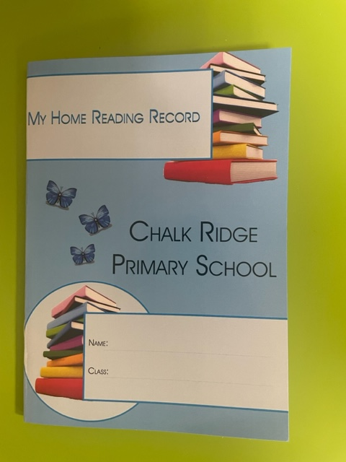
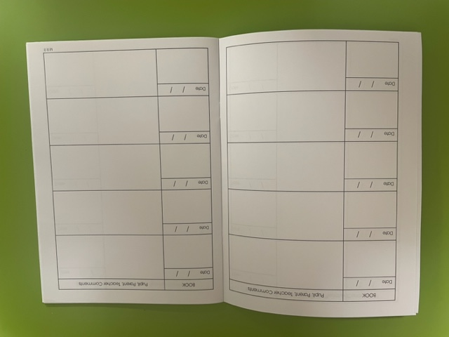
Reading Records
Date
Name of book/Page no.
Comments

Slide 9
Key Reading Texts
We ensure that the children are exposed to a variety of genres and text types throughout the year. This can be through: Reading practice sessions, English learning journey books, topic books and story time.

Slide 10
Reading and phonics in school
Readi
Reading Practice
This will continue in exactly the same way as in Year R and Year 1.
They will read the book 3x in school – once for decoding, once for prosody and once for comprehension.
An e book will be issued to be read at home.
Phonics
Children will be taught a phonics lessons daily.

Slide 11
Year 1
Our team…

Slide 12
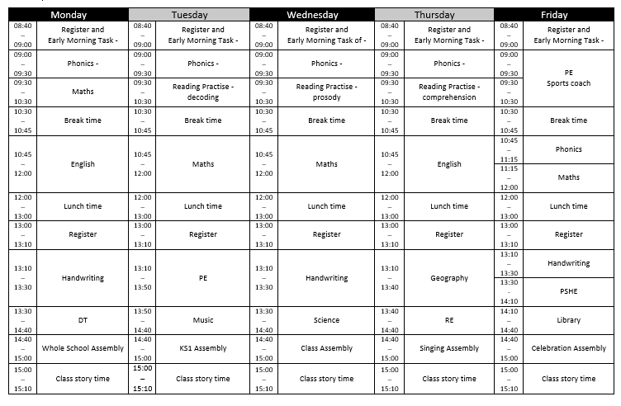
Timetable

Slide 14
Home Learning

Slide 15
Year 2
Our team…

Slide 16
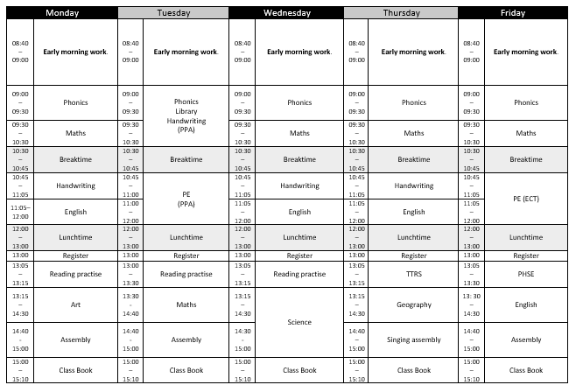
Year 2

Slide 17
Our Autumn Curriculum Information Overview

Slide 18
Home Learning

Slide 19
Each child in Year 2 will receive a login to a fun app called NumBots.
It helps children to master their addition, subtraction and number bonds knowledge in a fun, gamified way.
It is expected in Year 2 that each child will use the app at least 3 times a week.
This is the sister company for TTRS.

Slide 20
Key Dates This Term
Photographer in school on Thursday 14th September
School Census Day on Friday 6th October (no packed lunch day)
Fire safety talk 9th October (Year 2 and Year 6)
Home Learning due in on Monday 16th October (Year 2)
Parents Evenings on Tuesday 17th and Thursday 19th October
Inset Day on Friday 20th October

Slide 21
School Development Plan
2022 - 2023
Children will receive an ambitious broad and balanced curriculum each term
We implemented a new PSHE and PE curriculum.
Our RE, Spelling and Music curriculum were fully implemented.
With support from the Local Authority we have developed our Science, Geography and History curriculum.
We also worked on how we teach guided reading and implemented a new handwriting programme.
This year we are implementing a new Art, DT, French and computing curriculum.

Slide 22
School Development Plan
2022 - 2023
Progress and attainment in phonics is accelerated to enable good outcomes

Slide 23
School Development Plan
2022 - 2023
Attainment of lowest 20% and greater depth pupils improves as a result of targeted provision informed by precise use of assessment information.
KS1 reading GDS 13% (2021-2022 we had 0)
KS1 maths GDS 5% (2021-2022 we had 0)
KS2 reading 24%
KS2 SPaG 22%
KS2 maths 24% (better than national)
KS2 combined 19% (better than national)

Slide 24
School Development Plan
2022 - 2023
Persistent absence is reduced to less than 10%
We ended on 15% which is lower than the national but still too high for Chalk Ridge.
Persistent absence is defined by the Government as pupils missing 10% or more of their possible sessions.
We will continue to work hard on promoting positive school attendance.

Slide 25
School Development Plan 23-24
OFSTED
Quality of Teaching and Learning
Ensure all children make good progress from their starting points through high quality teaching.
Behaviour and Attitudes and Personal Development
Implement the Thrive Approach in school to support the mental health and well-being of children.
Leadership and Management (including governance)
Develop subject leadership of the foundation subjects to drive improvements in the quality of the foundation curriculum.

Slide 26
Updated Behaviour and Relationships Policy
Attendance – absence requests
School Census – 5th October 2023 (no packed lunches please)
PTA – AGM is on Thursday 28th September 23 6.30pm
Newsletter

