Slide 1
Year 3 and 4 Parent Workshop
Year 3
Miss Moore s.moore@chalkridgepri.hants.sch.uk
Mrs Saunders g.saunders@chalkridgepri.hants.sch.uk
Year 4
Mrs Shell-Allen r.shell-allen@chalkridgepri.hants.sch.uk
Mrs Burns h.burns@chalkridgepri.hants.sch.uk

Slide 2
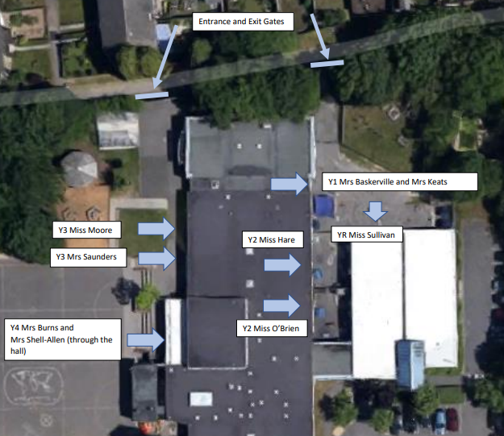
Drop off and Pick up
The gates are opened at 8:30am.
Classroom doors are opened at 8:40am. Children should arrive between 8:40am-8:50am.
If children arrive after 8:50am they need to go through the office and will be marked as late.
Children to be picked up at 3:10pm at the same place as they were dropped off.
Notes:
RSA

Slide 3
School Uniform
Navy-blue jumper/sweatshirt or cardigan (no hooded tops);
Light blue polo shirt, shirt or blouse;
Grey trousers, skirt or pinafore dress (summer cotton dress in blue and white);
White, navy-blue or grey socks/tights;
Conventional outdoor shoes in dark colours (conventional sandals may be worn in the summer);
Hair longer than shoulder length tied up in plain coloured hairbands.

Slide 4
PE School Uniform
Light blue t-shirt;
Navy blue PE briefs, shorts, jogging bottoms or wrap over games skirt;
Light blue fleece or sweatshirt (no hooded tops);
Trainers or plimsolls for outdoor PE.
Safety Notes
Earrings should be removed during all PE activities (taped if newly pierced).
All indoor PE in bare feet.
Hair longer than shoulder length tied up in plain coloured band.
No hooded tops allowed.

Slide 5
Equipment Needed
Your children will not be required to bring their own pencil
cases or equipment as this will be provided for them.
PE kit will be need to be worn into school on days where PE is taught.
Year 3 – Monday and Wednesday
Year 4B – Tuesday and Thursday
Year 4SA – Thursday and Friday
Please note, children are not allowed to bring toys or fiddle toys from home. Fiddle toys will be provided where needed.

Slide 6
Reading
Regularly listening to your child read and reading to your child
will benefit them. Through reading, children can:
Develop their sense of self
Improve emotional literacy
Develop empathy
At Chalk Ridge, the expectation is that children are listened to at home at least 5 times a week. For every five reads, the children will also receive a raffle ticket towards winning their own book to keep. Reading records need to be in school everyday and children will be given the opportunity to change their reading books weekly.

Slide 7
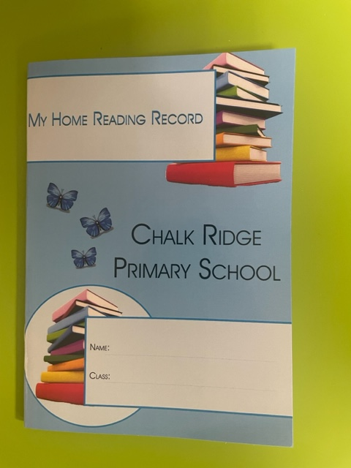
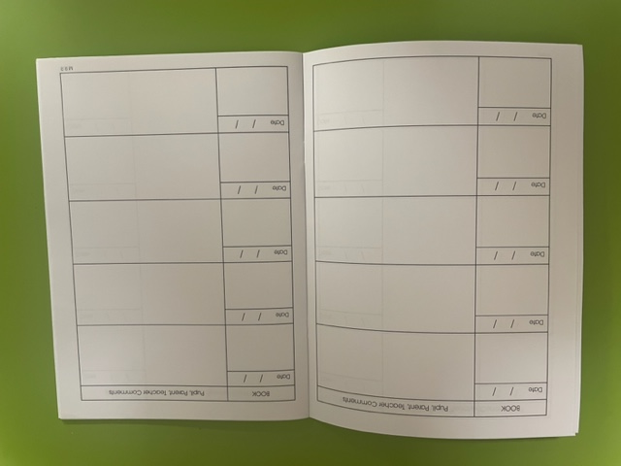
Reading Records
Date
Name of book/Page no.
Comments

Slide 8
Spellings
Children will be sent home up to 10 spellings a week. These will be taught and practised at school but also need to be regularly practised at home.
By the end of Year 4, children should be correctly spelling the Year 3 and 4 spellings words. The children should have a copy of these words stuck in their reading records for your access.

Slide 9
Key Reading Texts
We ensure that the children are exposed to a variety of genres and text types throughout the year. This can be through: Guided Reading sessions, English learning journey books, topic books and story time.

Slide 10
Times Tables Rock Stars
By the end of year 3, all children should be able to recall 2,5,10,3,4,6 and 8 times tables – including divisions. By the end of Year 4, all children should know up to their 12x12 times tables multiplication facts.
‘Times Tables Rockstars’ enables children to practise and learn times tables at home and school.
It enables them to improve their fluency and recall multiplication (and division) facts quickly.
Times Tables Rock Stars (ttrockstars.com)
Your child’s username and password should be stuck in their reading record so that it can be easily accessed.

Slide 11
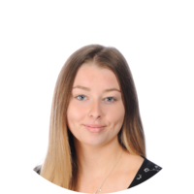
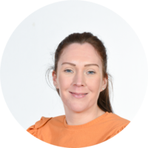
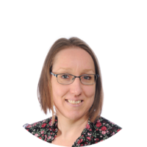
Year 3
Our team…

Slide 12
Stepping into KS2
We understand that the thought of KS2 can be daunting, for children and for parents. We hope that this presentation will ease any concerns.
The main differences between September in Year 2 and September in Year 3 are:
Children learn whilst sitting in their seat, rather than on the carpet
All children begin to use a pen to write, rather than a pencil
Children are expected to set out books in a certain way e.g. writing and underlining the date and title for each subject and drawing margins in Maths books.
All other expectations are the same as they always have been. The work is pitched at a level that they can all achieve and learn every day and – as always – the work gets progressively more challenging, the same way it does in all year groups.

Slide 13
Reading books
Last year, when your children were in Year 2 – they were reading through the Little Wandle Reading Program that we introduced to all KS1 children.
The success of using this program throughout KS1 after using this scheme was really high! The children are much more secure with reading and de-coding now.
Because of this, we have given your children reading books that you might find are easier than before. We have done this because we want your child to feel enabled to read the book independently.
When we hear your child read in the next few days/weeks, you might find that they are moved onto higher levels quicker than usual – but we want to be sure that they are secure with each level before they are moved on.

Slide 14
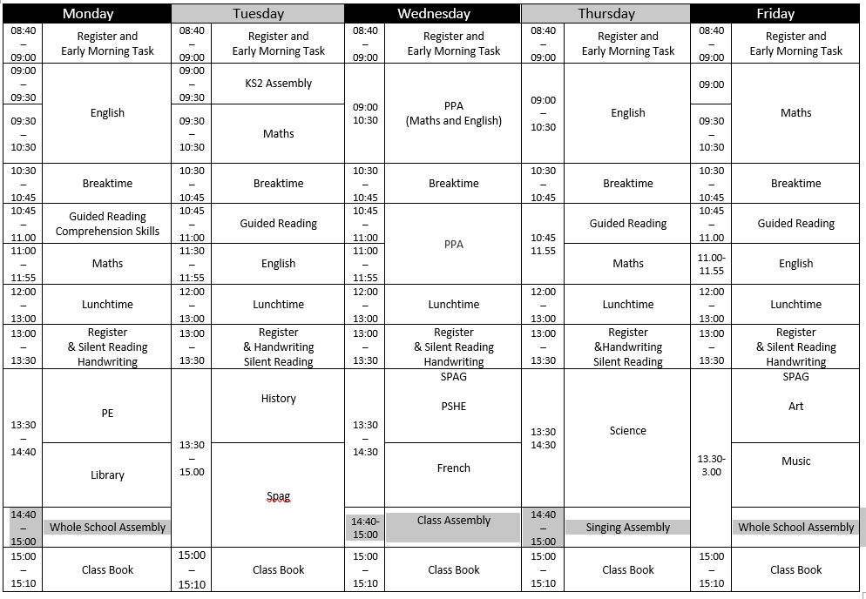
Timetable

Slide 16
Home Learning

Slide 17
Year 4
Our team…

Slide 18
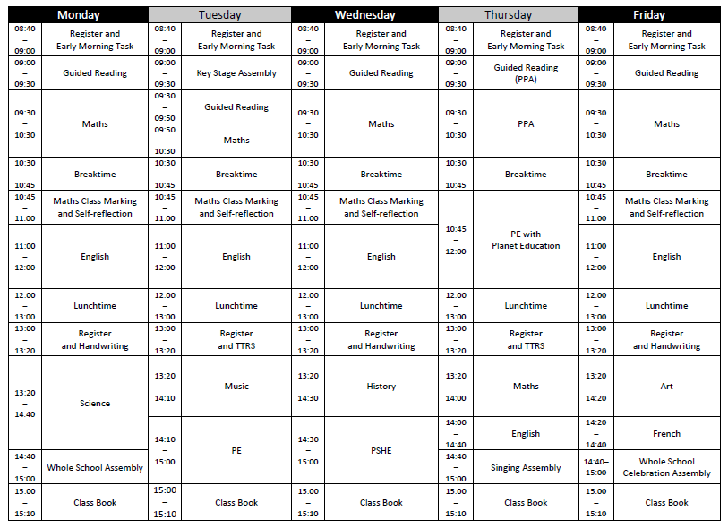
4B

Slide 19
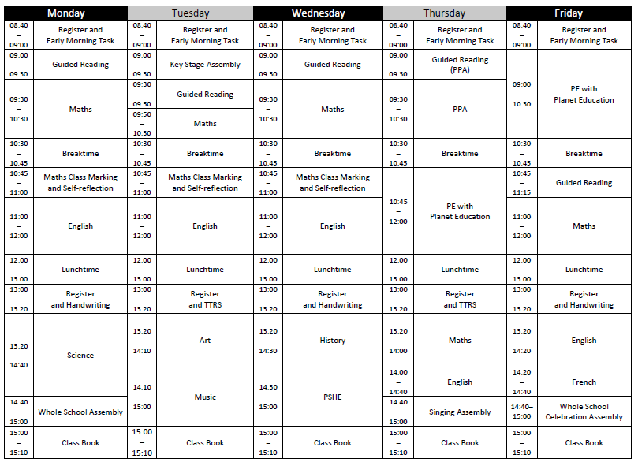
4SA

Slide 20
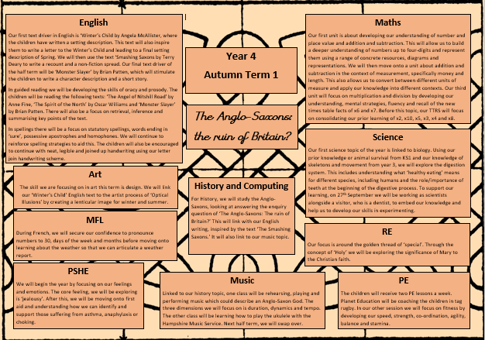
Our Autumn Curriculum Information Overview

Slide 21
Home Learning

Slide 22
Key Dates This Term
Photographer in school on Thursday 14th September
Year 4 - Dentist Visitor on Wednesday 27th September
School Census Day on Friday 6th October (no packed lunch day)
Year 3 - Stone Age Day on Thursday 12th October
Home Learning due in on Monday 16th October
Parents Evenings on Tuesday 17th and Thursday 19th October
Inset Day on Friday 20th October

Slide 23
School Development Plan
2022 - 2023
Children will receive an ambitious broad and balanced curriculum each term
We implemented a new PSHE and PE curriculum.
Our RE, Spelling and Music curriculum were fully implemented.
With support from the Local Authority we have developed our Science, Geography and History curriculum.
We also worked on how we teach guided reading and implemented a new handwriting programme.
This year we are implementing a new Art, DT, French and computing curriculum.

Slide 24
School Development Plan
2022 - 2023
Progress and attainment in phonics is accelerated to enable good outcomes

Slide 25
School Development Plan
2022 - 2023
Attainment of lowest 20% and greater depth pupils improves as a result of targeted provision informed by precise use of assessment information.
KS1 reading GDS 13% (2021-2022 we had 0)
KS1 maths GDS 5% (2021-2022 we had 0)
KS2 reading 24%
KS2 SPaG 22%
KS2 maths 24% (better than national)
KS2 combined 19% (better than national)

Slide 26
School Development Plan
2022 - 2023
Persistent absence is reduced to less than 10%
We ended on 15% which is lower than the national but still too high for Chalk Ridge.
Persistent absence is defined by the Government as pupils missing 10% or more of their possible sessions.
We will continue to work hard on promoting positive school attendance.

Slide 27
School Development Plan 23-24
OFSTED
Quality of Teaching and Learning
Ensure all children make good progress from their starting points through high quality teaching.
Behaviour and Attitudes and Personal Development
Implement the Thrive Approach in school to support the mental health and well-being of children.
Leadership and Management (including governance)
Develop subject leadership of the foundation subjects to drive improvements in the quality of the foundation curriculum.

Slide 28
Updated Behaviour and Relationships Policy
Attendance – absence requests
School Census – 5th October 2023 (no packed lunches please)
PTA – AGM is on Thursday 28th September 23 6.30pm
Newsletter

