Slide 1
Year 5 and 6 Parent Workshop
Year 5
Miss Perry m.perry@chalkridgepri.hants.sch.uk
Miss Relf l.relf@chalkridgepri.hants.sch.uk
Mrs Taylor a.taylor@chalkridgepri.hants.sch.uk
Year 6
Mr Lyddy r.lyddy@chalkridgepri.hants.sch.uk
Mr Green t.green@chalkridgepri.hants.sch.uk

Slide 2
Upper Key Stage Two (Year 5 and 6)
Year 5
Mrs Taylor Miss Relf Miss Perry
Mrs Powell Miss Spekes
Year 6
Mr Green Mr Lyddy
Mrs Trowbridge Mrs King Mrs Neal

Slide 3
School Uniform
Navy-blue jumper/sweatshirt or cardigan (no hooded tops);
Light blue polo shirt, shirt or blouse;
Grey trousers, skirt or pinafore dress (summer cotton dress in blue and white);
White, navy-blue or grey socks/tights;
Conventional outdoor shoes in dark colours (conventional sandals may be worn in the summer);
Hair longer than shoulder length tied up in plain coloured hairbands.

Slide 4
PE School Uniform
Light blue t-shirt;
Navy blue PE briefs, shorts, jogging bottoms or wrap over games skirt
Light blue fleece or sweatshirt (no hooded tops);
Trainers or plimsolls for outdoor PE.
Safety Notes
Earrings should be removed during all PE activities (taped if newly pierced).
All indoor PE in bare feet.
Hair longer than shoulder length tied up in plain coloured band.
No hooded tops allowed.

Slide 5
Equipment Needed
In Year 6 your children should bring in their own pencil case. We will provide a pen, pencil, ruler, glue and rubber.
In Year 5, your child will not be required to bring in their own pencil case as all equipment will be provided for them.
It would be helpful if you could provide your child with a folder for storage of on-going work and homework for both Years 5 and 6.
PE kit will be need to be worn into school on days where PE is taught.
Year 5 – Monday and Thursday
Year 6 – Monday and Friday
When completing homework, your child may need additional equipment to complete projects successfully and to a high standard. This may include pens, pencils rulers, pritt-sticks, pens, colouring pens and/or pencils.
Please note, children are not allowed to bring toys or fiddle toys from home. Fiddle toys will be provided where needed.

Slide 6
Home Learning
Home is integral to securing good progress throughout Primary School. It is vital to support learning in Years 5 and 6 as this enables children to consolidate learning in class and helps prepare for statutory testing.
Home learning in Years 5 and 6 also prepares children when they make their transition to secondary school.
Chalk Ridge home learning for the academic year 2023/24 has changed.

Slide 7
Home Learning
All children will complete a project once a term.
They will be given a selection of options and children can then choose which project they would like to do and share with their class during the last week of the term.
The project will link to one of the topics they are studying in school to deepen their understanding and inspire their curiosity.

Slide 8
Year 6 – Home Learning

Slide 9
Times Tables Rock Stars
‘Times Tables Rockstars’ enables children to practise and learn times tables at home and school.
It enables them to improve their fluency and recall multiplication (and division) facts quickly.
Times Tables Rock Stars (ttrockstars.com)

Slide 10
Reading
Regularly listening to your child read and reading to your child will benefit them. Through reading, children can:
Develop their sense of self
Improve emotional literacy
Develop empathy
At Chalk Ridge, the expectation is that children are listened to at home at least 5 times a week. For every five reads, the children will also receive a raffle ticket towards winning their own book to keep. Planners need to be in school everyday and children will be given the opportunity to change their reading books weekly.

Slide 11
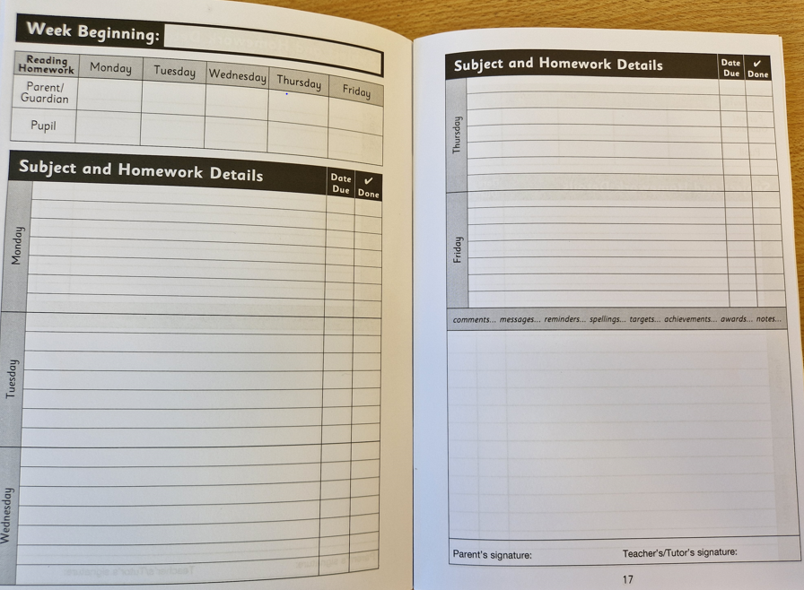
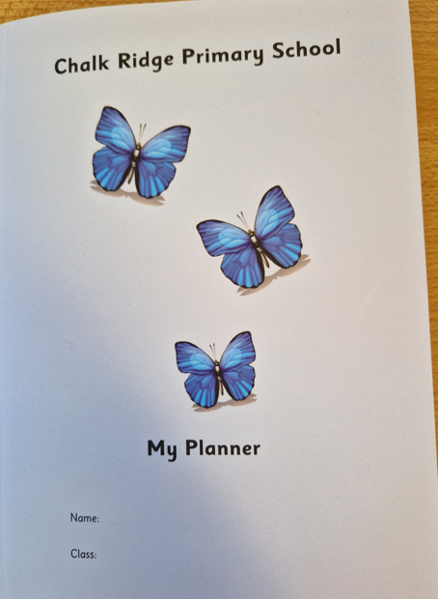
Planners

Slide 12
Key events this year
Photographer in school on Thursday 14th September
School census day on Thursday 5th October – We encourage children to have a hot school dinner!
Fire safety talk 9th October
School Disco TBC
Parents Evenings on Tuesday 17th and Thursday 19th October
PGL – Monday 6th – Friday 10th November
Height and weight check
Year 5 - WWII evacuee day – Friday 17th November
‘Bike Ability’ - week beg 20th November
Swimming
End of year performance
Leavers assembly
Transition days

Slide 13
Topics throughout the year
Autumn | Spring | Summer
Topic: World War II Science: Fossils, geological time and classification Space and gravity | Topic: River Tees compared to our local area Science: Space and gravity continued Making new substances | Topic: Australia natural resources Ancient Egyptians Science: Forces that oppose motion Circulation

Slide 14
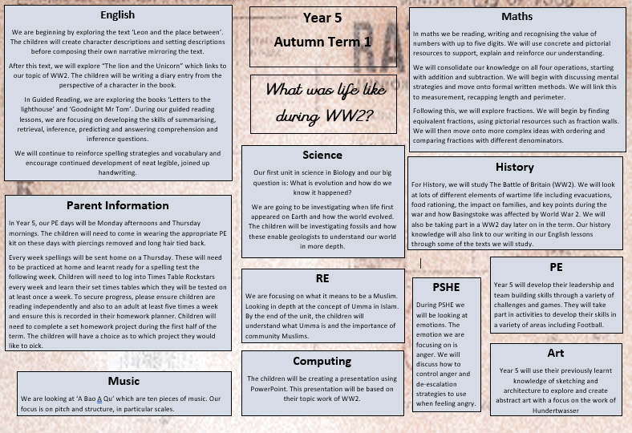
Year 5

Slide 15
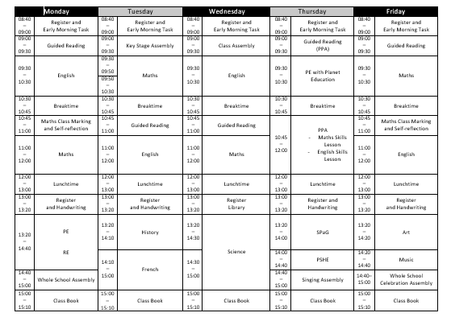
Year 5

Slide 16
Key Texts

Slide 17
NFER Papers
NFER papers prepare children for SATs in Year 6.
They help to highlight gaps in children’s knowledge.
The layout is similar to SATs papers so children become familiar with question types and expectations.
Towards the end of year 5, children will be given SATs papers.

Slide 18
Topics throughout the year
Autumn | Spring | Summer
Topic: Comparing Brazil with our local area Magna Carta Science: How light behaves. Evolution and classification | Topic: Ancient Greeks Science: Electricity – controlling circuits | Topic: Earthquakes Science: Sound

Slide 19
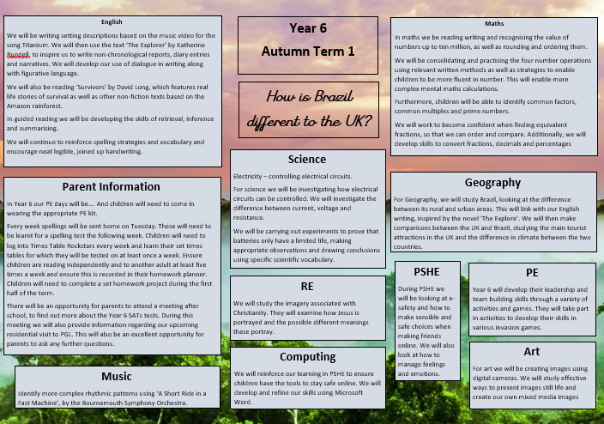
Year 6

Slide 20
Weekly Time Table

Slide 21
Key Texts

Slide 22
SATs
SATs tests have been designed to give a measure of attainment in three subject areas:
Reading
Mathematics
Spelling, punctuation and grammar
These tests are set and marked externally, and the results are used to measure the school’s performance (for example, through reporting to Ofsted and published league tables). Your child’s marks are used, in conjunction with their teacher's assessment, to give a broad picture of their levels of attainment which is important when making their transition to Year 7.
Tests will begin on the week beginning Monday 13th May 2024

Slide 23
Reading and Spelling, Punctuation and Grammar
The reading test is a single paper with questions based on three passages of text. Your child will have one hour, including reading time, to complete the test.
The Spelling Punctuation and Grammar (SPAG) test consists of two papers. A 45 minute test, followed by a spelling test where children will be tested on 20 different words.

Slide 24
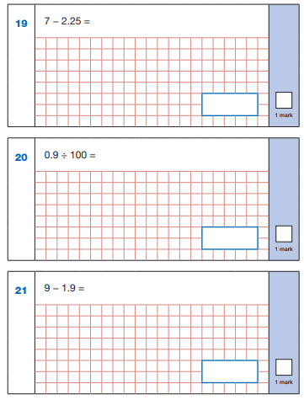
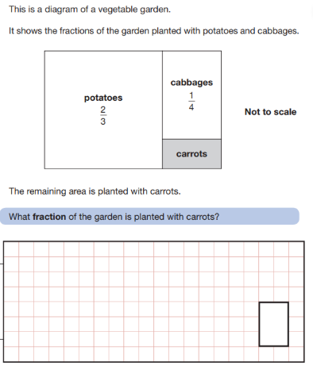
Maths
Maths consists of 3 papers: An arithmetic paper and two reasoning papers.

Slide 25
How to support your child
Regular reading
Ask questions - Who? – How do you know? What do you think? Prove it?
Regular Times table practice
Mental maths practice for fluency
Spelling rules and the Y3/4/5/6 spelling list
Prepare for the week with food and sleep!

Slide 27
School Development Plan
2022 - 2023
Children will receive an ambitious broad and balanced curriculum each term
We implemented a new PSHE and PE curriculum.
Our RE, Spelling and Music curriculum were fully implemented.
With support from the Local Authority we have developed our Science, Geography and History curriculum.
We also worked on how we teach guided reading and implemented a new handwriting programme.
This year we are implementing a new Art, DT, French and computing curriculum.

Slide 28
School Development Plan
2022 - 2023
Progress and attainment in phonics is accelerated to enable good outcomes

Slide 29
School Development Plan
2022 - 2023
Attainment of lowest 20% and greater depth pupils improves as a result of targeted provision informed by precise use of assessment information.
KS1 reading GDS 13% (2021-2022 we had 0)
KS1 maths GDS 5% (2021-2022 we had 0)
KS2 reading 24%
KS2 SPaG 22%
KS2 maths 24% (better than national)
KS2 combined 19% (better than national)

Slide 30
School Development Plan
2022 - 2023
Persistent absence is reduced to less than 10%
We ended on 15% which is lower than the national but still too high for Chalk Ridge.
Persistent absence is defined by the Government as pupils missing 10% or more of their possible sessions.
We will continue to work hard on promoting positive school attendance.

Slide 31
School Development Plan
OFSTED
Quality of Teaching and Learning
Ensure all children make good progress from their starting points through high quality teaching.
Behaviour and Attitudes and Personal Development
Implement the Thrive Approach in school to support the mental health and well-being of children.
Leadership and Management (including governance)
Develop subject leadership of the foundation subjects to drive improvements in the quality of the foundation curriculum.

Slide 32
Updated Behaviour and Relationships Policy
Attendance – absence requests
School Census – 5th October 2023 (no packed lunches please)
PTA – AGM is on Thursday 28th September 23 6.30pm
Newsletter

